Slide 1
ItWorks
Changing the way people find solutions

Slide 2



Our Team
Lisa Frankel
Rong Fang
Tian Lin
Software Engineer
Software Engineer
Software Engineer

Slide 3

Have a problem?
Google it!

Slide 4

The solution…?
Hold your breath
Stick out your tongue
Scare them away
Choke on hot water
Stimulate the Vagus Nerve
Reduce Stress
Notes:
Sticking out your tongue sounds like trolling. There is no definite proof on which solution actually works.

Slide 5

The solution…?
Too many solutions!
Which one will work?
Too few solutions!
What if there is a better way?
No solution!
What if there is one?
Notes:
Burnt Finger cure, most results on front page is to put cold water. But there may be better solutions that people don’t know about.
Lisa can mention the salt on burnt finger work for her.
Rong can mention the brake parts he bought on amazon which didn't fit the vehicle.
I can also talk about how maybe you even search through comments trying to figure out which solutions actually worked

Slide 6

Did you know?
There are no feedback based online forums for finding solutions to everyday problems.
Notes:
Most websites nowadays are SEO optimized so that their sites are competitive and will show on the first few search pages. they are the most relevant answers, but might not be the best answer.
Many businesses buys fake clicks or fake reviews to create fake traffic to get their web site up in ranking so that they would show up on the front pages of the google search result.

Slide 7
So what?
People need answers to problems fast
They want to know which one will work
If it worked for all of them… it might work for me!
Notes:
In some cases, you need an answer within 5 minutes

Slide 8
So what?
We can build a community focus on providing reliable answers
Answer will have feedback to prove that they work

Slide 9
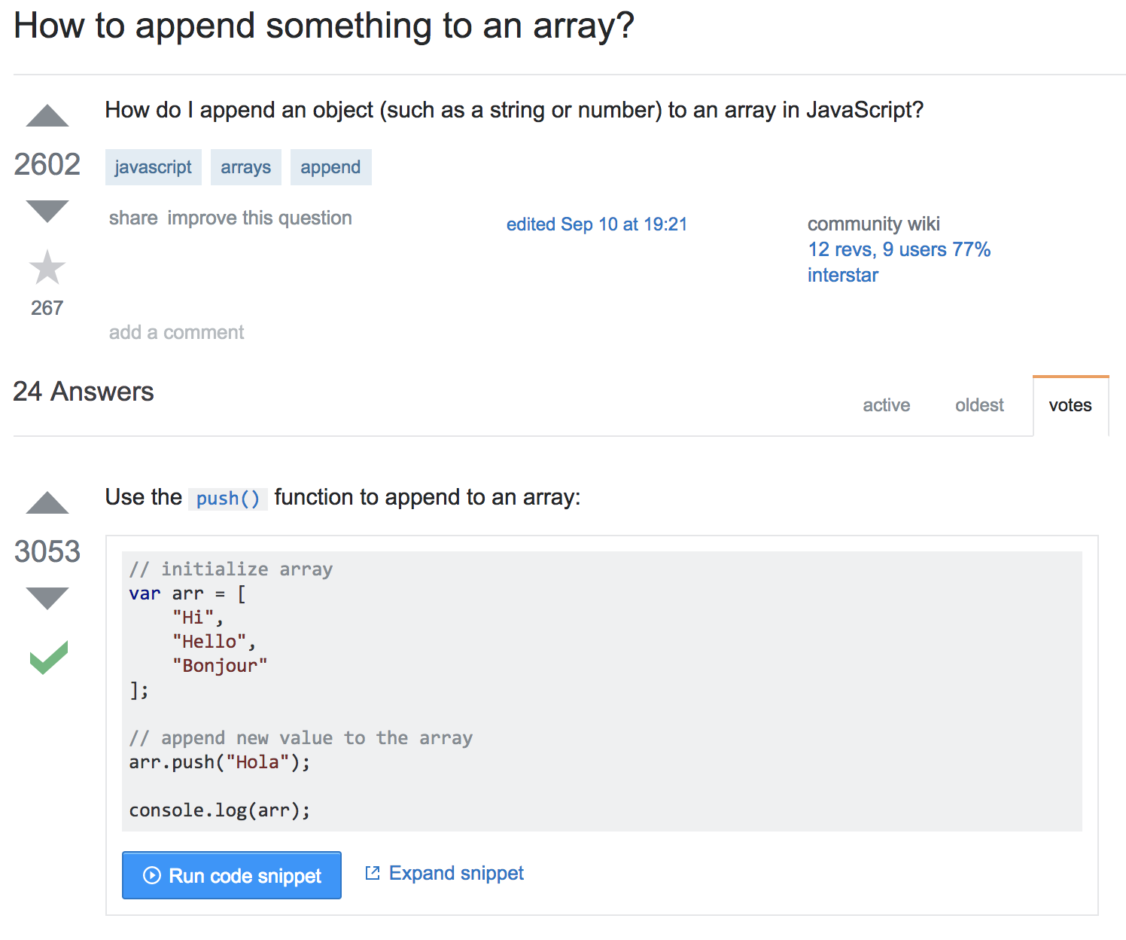
What’s already out there
Stackoverflow
Rate best answers to questions
Reddit
Answer broad range of questions
Notes:
We are inspired by stackoverflow of the formal way they provide answers to the engineering questions. Our goal is to create a product similar to stackoverflow, but not specifically for engineering.
Reddit can give you answer to anything and it is not specific to only computer engineering questions.

Slide 10
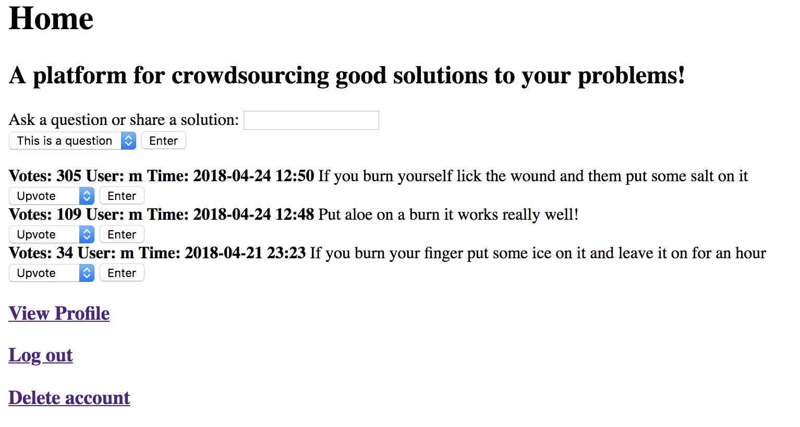
Enter ItWorks

Slide 11
How ItWorks Works
Crowdsourcing solutions to real problems
User feedback allows users to determine the quality of solutions
More efficient than searching through comments to guess as to what's effective
Gives users confidence in a solution

Slide 12
How ItWorks Works
Feedback
Upvote/Downvote
Reputation
Search for posts
E.g. ask a question
Share solutions
Moderate
Flag/unflag posts
Notes:
Key features

Slide 13
How ItWorks Works
Moderating system to filter results and flag user’s / posts
Users can report spam activity to the Moderators
This ensures no dangerous posts remain on the system

Slide 14
Motivations
Customers:
Seeking answers
More reliable answers
Posting answers
Sharing is caring, and get reputation for it
Stakeholders:
Ad revenue
B2B - package our data to businesses

Slide 15
Future plans
Improve UI
Porting to android/iOS in the future.
Add features (comments, browse, etc.)
Get people using the site
Make the site more accessible
Package data for businesses
Monetize (e.g. embed ads)
Notes:
The answers will be divided into categories such as computer engineering / mechanical engineering. Job posting

Slide 16
Post implementation review
What we did right
Weekly meeting in person
Architecture design
Bottom up approach
What we did wrong
Began programming earlier
Set fewer goals for initial application
What would we change.
Have people interact with our app

Slide 17

Any questions?

